Slide 1
LOCATION INSIGHTS FROM TOP TRAVEL DESTINATIONS

Slide 2
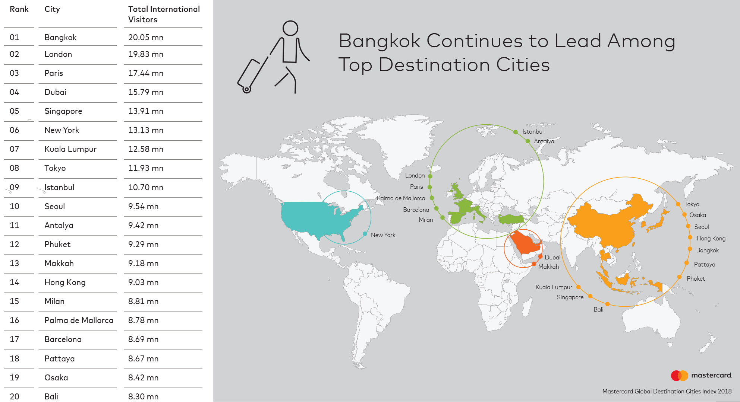
Travel and tourism are big economy boosters.
The MasterCard destination index records
above 9 million annual visitors for top ten destinations.

Slide 3
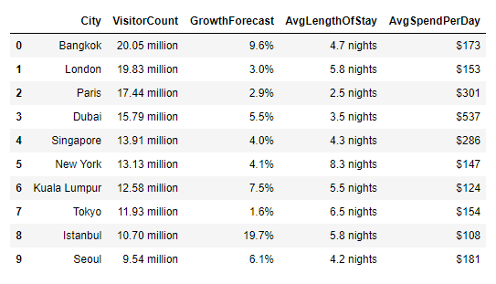
Some destinations
benefit from an
average visitor daily
spend of as high
as $537

Slide 4


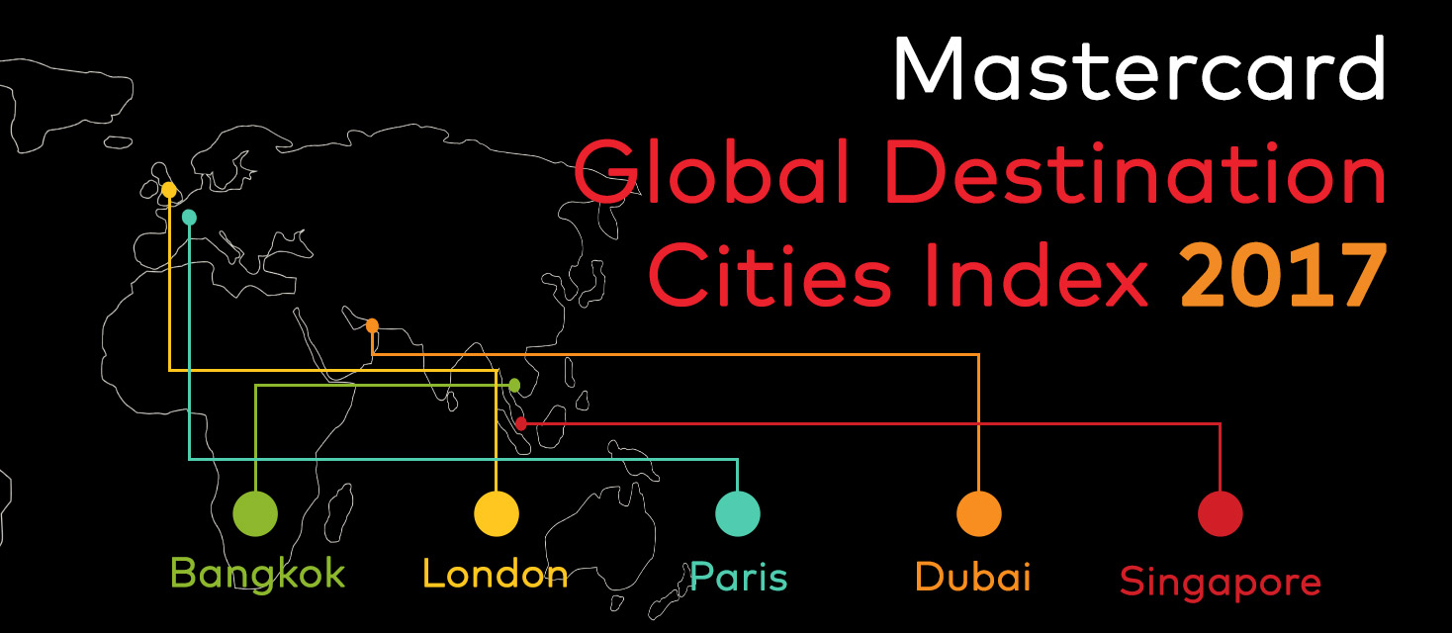
Geopy Nominatim Geocoder
We can learn from these destinations using location data.
MasterCard Destination Cities Index
Foursquare API

Slide 5
Trends from Analysis

Slide 6
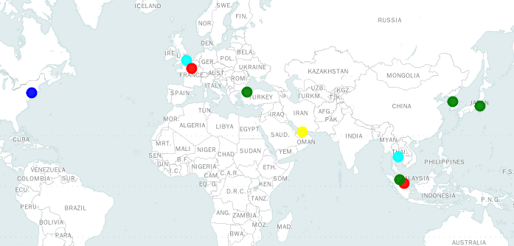
Most Top Ten Destinations are in Asia

Slide 7
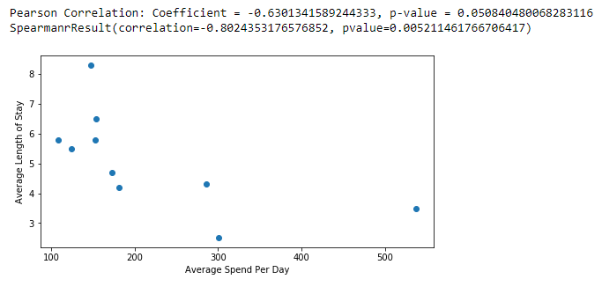
People generally stay longer in cities where spending is less

Slide 8
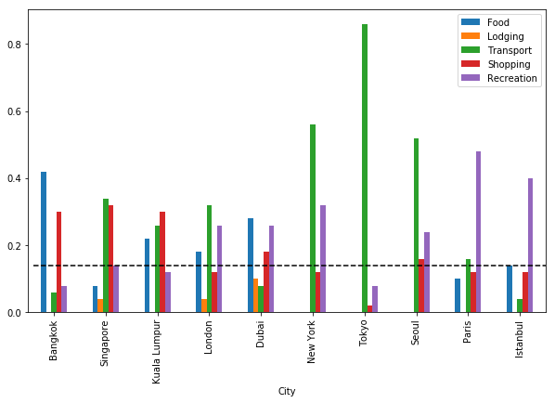
Dubai and Singapore have high average daily spend
Average spend per day increase with lodging cost. Cities which do not prioritize accommodation are less expensive to visit.

Slide 9
Transportation is the most important sector for top cities

Slide 10
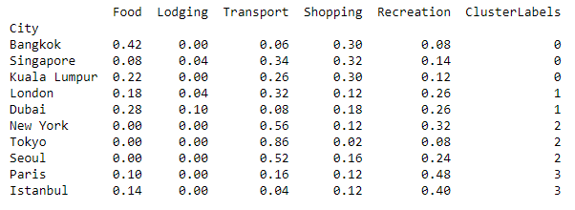
Top cities have varied
priorities. Each city’s priority works for it. Potential cities can leverage their strong advantages.

Slide 11
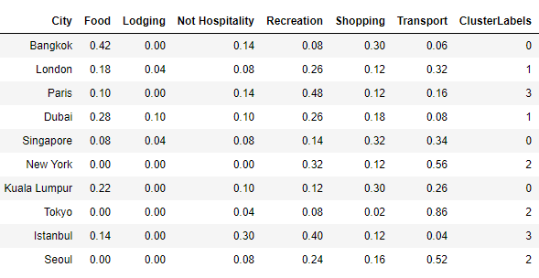
Similar and Dissimilar Cities through
K-Means Clustering

Slide 12
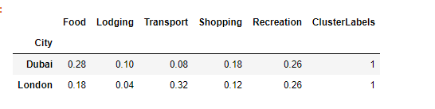
London and Dubai have comparable sector prioritization.
They priotize market diversity.

Slide 13
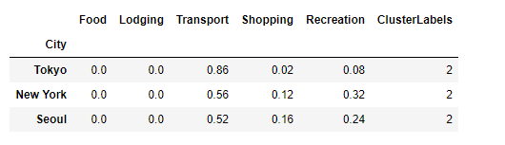
New York, Tokyo and Seoul have comparable sector prioritization.
They prioritize Transportation and Recreation.

Slide 14
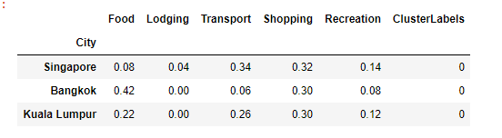
Bangkok, Singapore and Kuala Lumpur prioritize shopping.
Bangkok additionally prioritizes Food, while Singapore prioritizes Transportation.

Slide 15
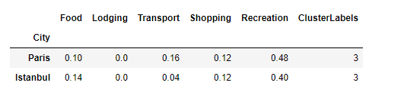
Paris and Istanbul
prioritize recreation
and shopping.

Slide 16
Trends that need further exploration

Slide 17
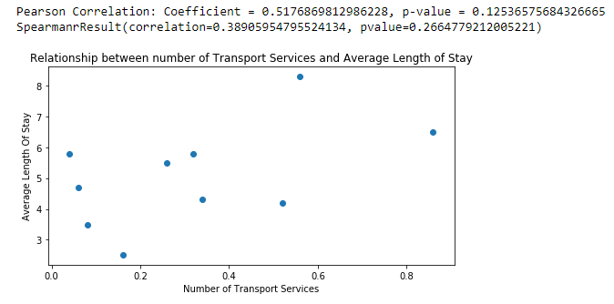
The relationship between Transportation and Average length of stay is not statistically significant

Slide 18
Conclusion and future analyses

Slide 19
Tourism is a rewarding sector for economies
which take it seriously. Tourism success depend
largely on Transportation, Recreation, and Shopping.
Potential cities may benefit from developing these
sectors.

Slide 20
This analysis is exploratory and a precursor to a
more comprehensive analysis.
Future analysis will leverage location data for more
cities and their sub regions.

